Slide 1
General Irreversibility and Irrationality in economic transactions
A formal basis for extension of existing economic modelling with behavioural deviation from the Fully Informed Rational Decision-making
Ir.Marcel van Berlo, 27-10-2022

Slide 2
INDEX
Background
Choice-Space
Model of Economic Transactions
Decisionmaking

Slide 3
Physics in time
Newton: 4 laws + differential equation
No friction: works in space
Friction: to accommodate on earth
Movement of pendula
Euler: Describe waves
Navier-Stokes: Waves with viscosity
Maxwell: EM-waves
Clausius, Boltzman, Gibs, Einstein, Plank: Thermodynamics

Slide 4
Economics in time
Adam Smith:
Utilitarianism
Invisible hand
John Stuart Mill, Jevons: Rational choice
Walras:
Marginal theory of value
General Equilibrium
Nash: Equilibrium(strategy)
Kenneth Arrow, Gérard Debreu, Lionel W. McKenzie: 1st & 2nd theorem
Schumpeter:
Georgescu-Roegen: --

Slide 5
Rationality
Rational choice theory has proposed that there are two outcomes of two choices regarding human action. Firstly, the feasible region will be chosen within all the possible and related action. Second, after the preferred option has been chosen, the feasible region that has been selected was picked based on restriction of financial, legal, social, physical or emotional restrictions that the agent is facing. After that, a choice will be made based on the preference order. Jan Jonge, 2012^{[9]}

Slide 6
2. Choice-Space
The pre-defined set of all possible (combinations) of choices.
Two separate choices:
Definition of a choice-space.
Economic choice out of all options within the choice-space.
The definition of the choice-space can involve multiple dimensions with multiple criteria.
As the number of dimensions grows the number of possible (combinations) of choices grows astronomically.
A choice-space can be nested: it is part of a wider choice-space.

Slide 7
Binary Choice

Slide 9
3. Model of economic transactions
Value & Information
Mass & Energy
Economic Agent
Value & Information
Mass & Energy
Choice-Space
Choice-Space
MARKET
SOCIETY
Mass & Energy
Mass & Energy
EARTH

Slide 10
Model of economic transactions
An economic transaction involves a choice within a choice-space
The aim of the rational agent is to make a FIRD
In practice there is a difference between the FIRD and the actual choice
The value of this difference is due to the incomplete use of all the information needed to establish the FIRD
In economic modelling there is no place to systematically model the incomplete use of all information

Slide 11
Rational decision-making
Fully Informed Rational Decision-making (FIRD)
Involves an evaluation of ALL options
To a (value) criterium that determines optimallity
With ALL information that influences the value
Then chooses the best option in the choice-space.

Slide 12
Non-FIRD
For all real-world decisions:
The information that is available is incomplete (even ex-post)
The number of possible (combinations) of choices is more than can be possibly evaluated
Heuristic decision-making
The behavioural noise an bias (Kahneman) deviate from a FIRD

Slide 13
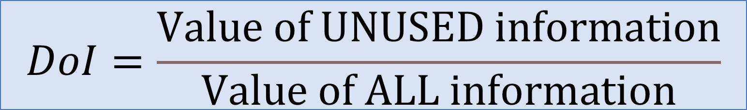
Formula: Degree of Irrationality (DoI)
$$DoI=\frac{Value of UNUSED information}{Value of ALL information}$$
A DoI is specific for one decision, by one decisionmaker, in one choice-space with a fixed evaluation criterium.
A DoI is normalised in a scale from
0% = FIRD
100% = pure random decision
DOI can be averaged to over decisions, groups or choice-spaces
DoI_{avg} represents average behavioural distance from FIRD

Slide 14

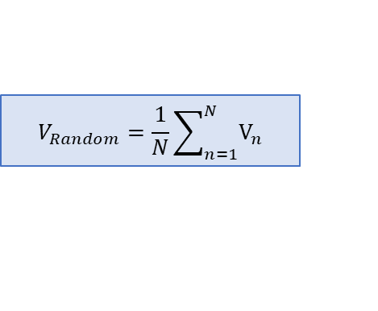


Value of information
INFORMATION
NONE is used in Random choice
Average value over all possible choices
ALL is used in FIRD
Find the best possible out of all possible choices
$$V_{Random}=\frac{1}{N}\sum_{n=1}^{N}{V_{n}}$$
$$V_{FIRD}= MAX \left(V_{n}\right)$$
VALUE
UNUSED information
The difference between the optimal and real transaction
ALL information
The difference between FIRD over Random choice
${∆V}_{UNused info}=$ $V_{FIRD}$ - $V_{Transaction}$
$$ΔV_{ALL info}= V_{FIRD}− \overline{V_{Random}}$$

Slide 15
Reversibility
In establishing a general equilibrium all prices optimised till no further transaction gives any yield.
In a general equilibrium the next transaction will be reversible, both partners will have no obligation against undoing the transaction (with the transaction cost set to zero)
In our society economic transactions are IRreversible by agreement and legal regulations
This dichotomy plays a role in limited accuracy of economic modelling.

Slide 16

Separation of Properties
$$V_{AVG Transaction}= V_{FIRD}− \overline{DoI}∙ ΔV_{ALLinfo}$$
Conventional Rational modelling
Behaviour: $\overline{DoI}$ is the average deviation of rational behaviour
Choice-Space: ${ΔV}_{ALLinfo}=V_{FIRD}− \overline{V_{Random}}$ is the value of information to make an Optimal choice

Slide 17
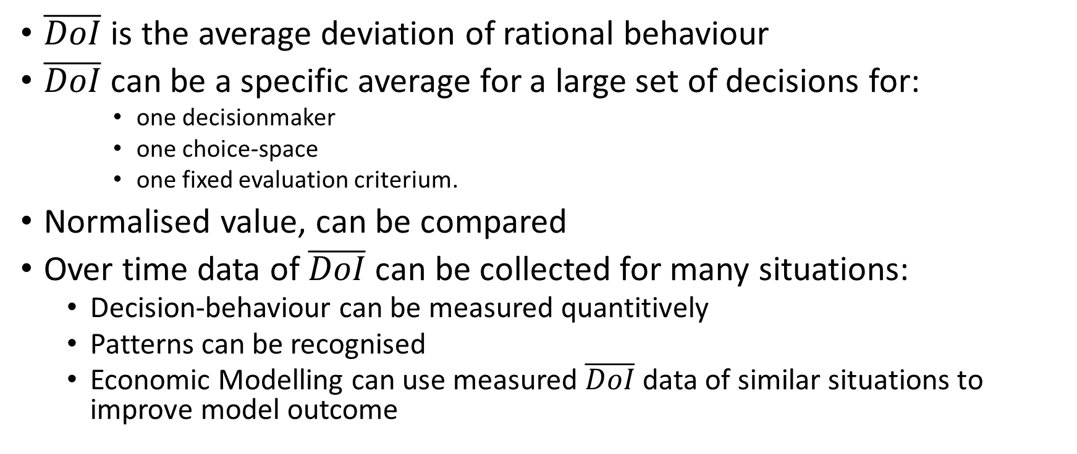
Behaviour
$\overline{DoI}$ is the average deviation of rational behaviour
$\overline{DoI}$ can be a specific average for a large set of decisions for:
one decisionmaker
one choice-space
one fixed evaluation criterium.
Normalised value, can be compared
Over time data of $\overline{DoI}$ can be collected for many situations:
Decision-behaviour can be measured quantitively
Patterns can be recognised
Economic Modelling can use measured $\overline{DoI}$ data of similar situations to improve model outcome

Slide 18
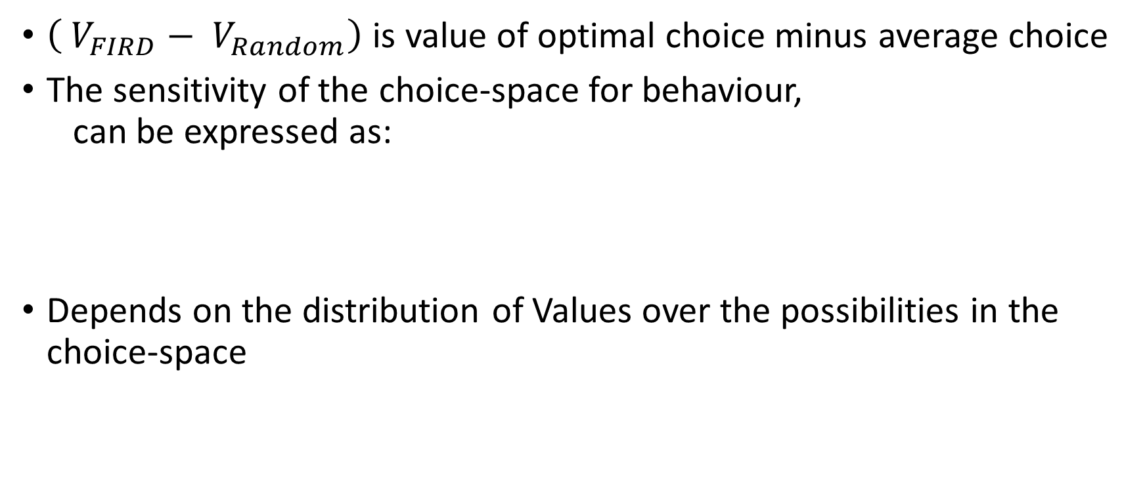
Choice-Space
$\left( V_{FIRD}− V_{Random}\right)$ is value of optimal choice minus average choice
The sensitivity of the choice-space for behaviour, can be expressed as:
Depends on the distribution of Values over the possibilities in the choice-space
$$CSsensitivity= {\overline{ΔV_{ALLinfo}}}/{\overline{\%DoI}}∗100\%$$

Slide 19



Model of transactions
Economic Agent
Assume:
Agent and Market have same ValueFunction
$${ΔV}_{Agent}=+ ΔV_{Transaction}$$
$${ΔV}_{Transaction}= ΔV_{Rev }+ ΔV_{Irr }$$
$${ΔV}_{Transaction}$$
Choice-Space
$${ΔV}_{Market}= − ΔV_{Transaction}$$
MARKET
SOCIETY

Slide 20
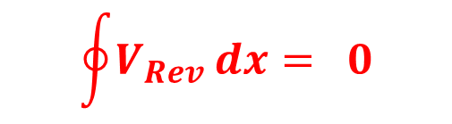
Reversible transactions
Economic Agent
$$\oint{V_{Rev}}dx= 0$$
$${ΔV}_{Transaction}= ΔV_{Rev }+ ΔV_{Irr }$$
Choice-Space
MARKET
SOCIETY

Slide 21
Future
Text collection has to be organised, rewritten
Formulas have to be made constent in formulation
Further development of formula set to specific cases
Excel has to be made to full simulation mock-up
Collecting behavioural example-data.
Publish
Present
Build software package

Slide 22
More information
Ir. Marcel van Berlo Vlinderweg 12 1432MH Aalsmeer +31-6-50602831 berlo.marcel@gmail.com
See conceptual descriptions in Berlo 2022 dagboek
See conceptual model in Berlo 2022

